Slide 1

Database Systems
Chapter 14
Mr. Faizad Ullah
Lecturer Computer Science

Slide 2
CHAPTER 14
The Basics of Functional Dependencies and Normalization for Relational Databases

Slide 3
Normalization
Normalization is the process of reorganizing/restructuring data in a database with a series of so called normal-forms, so that it meets two basic requirements:
(1) There is no redundancy of data (all data is stored in only one place), and
(2) data dependencies are logical (all related data items are stored together).
Normalization is important for many reasons, but chiefly because it allows databases to take up as little disk space as possible, resulting in increased performance.

Slide 4
Informal Design Guidelines for Relational Databases
We first discuss informal guidelines for good relational design
Then we discuss formal concepts of functional dependencies and normal forms

Slide 5
Informal Design Guidelines for Relational Databases
What is relational database design?
The grouping of attributes to form "good" relation schemas
Two levels for measuring the “goodness” of relation schemas
The logical (conceptual) level, i.e., user view
The implementation (physical storage) level, i.e., tuples store in base relation.
Design is concerned mainly with base relations
What are the criteria for "good" base relations?

Slide 6
Informal Design Guidelines for Relational Databases
Semantics of the attributes must be clear in the schema
Reducing the redundant information
Reducing the NULL values
Disallowing the possibility of generating spurious tuples

Slide 7
1. Semantics of the Relational Attributes must be clear
GUIDELINE 1: Informally, each tuple in a relation should represent one entity or relationship instance. (Applies to individual relations and their attributes).
Attributes of different entities (EMPLOYEEs, DEPARTMENTs, PROJECTs) should not be mixed in the same relation
Only foreign keys should be used to refer to other entities
Entity and relationship attributes should be kept apart as much as possible.
Bottom Line: Design a schema that can be explained easily relation by relation. The semantics of attributes should be easy to interpret.

Slide 8
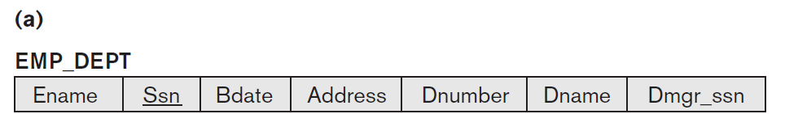
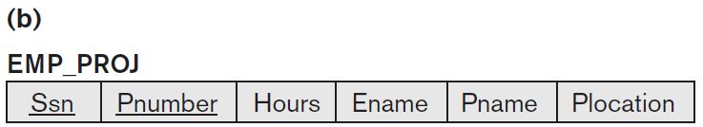
EXAMPLE

Slide 9
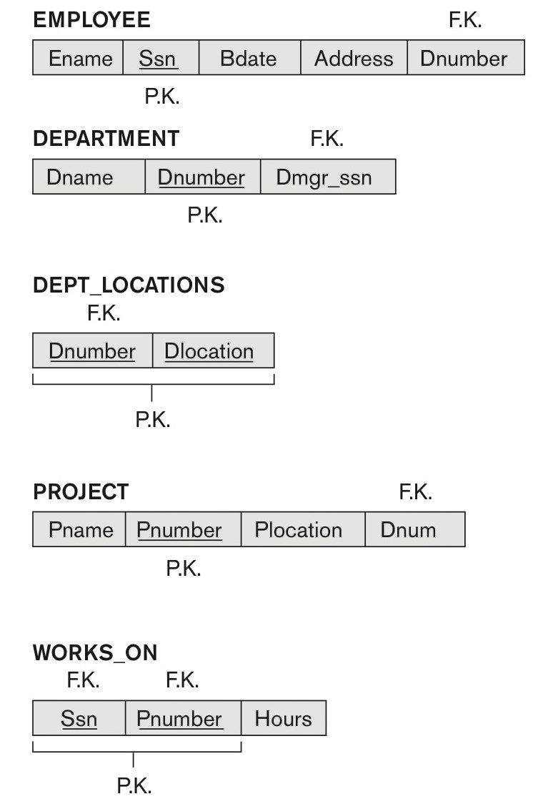
Company Database
Figure 14.1 A simplified COMPANY relational database schema.

Slide 10
Violating Guideline 1
By mixing attributes from distinct real-world entities

Slide 11
2. Redundant Information in Tuples and Update Anomalies
GUIDELINE 2:
Design a schema that does not suffer from the anomalies.
Note the anomalies and take them into account.

Slide 12
2. Redundant Information in Tuples and Update Anomalies
One goal of design schema is to minimize the storage space
By violating guideline 2:
Information is stored redundantly
Wastes storage
Causes problems such as
Insertion anomalies
Deletion anomalies
Modification anomalies

Slide 13
EXAMPLE OF AN INSERT ANOMALY
Consider the relation:
EMP_PROJ(Emp#, Proj#, Ename, Pname, No_hours)
Insert Anomaly:
Insert new employee in tuple
i) Add department or ii) NULL department
It is difficult to add department with zero (NULL) employees
Entity integrity

Slide 15
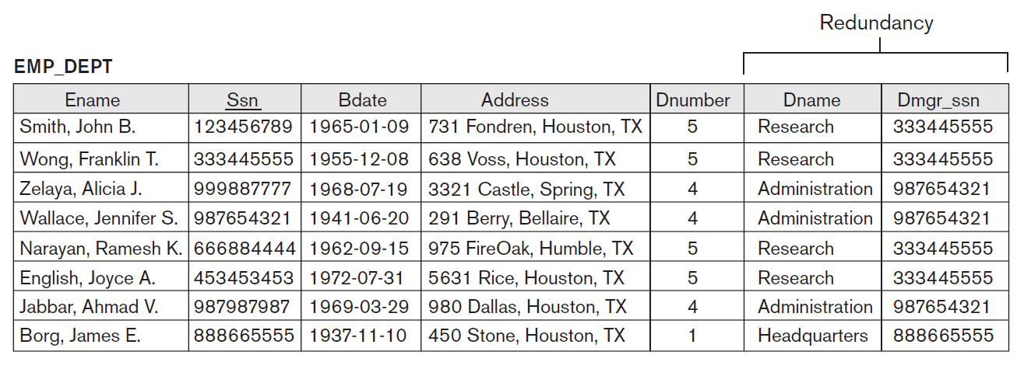
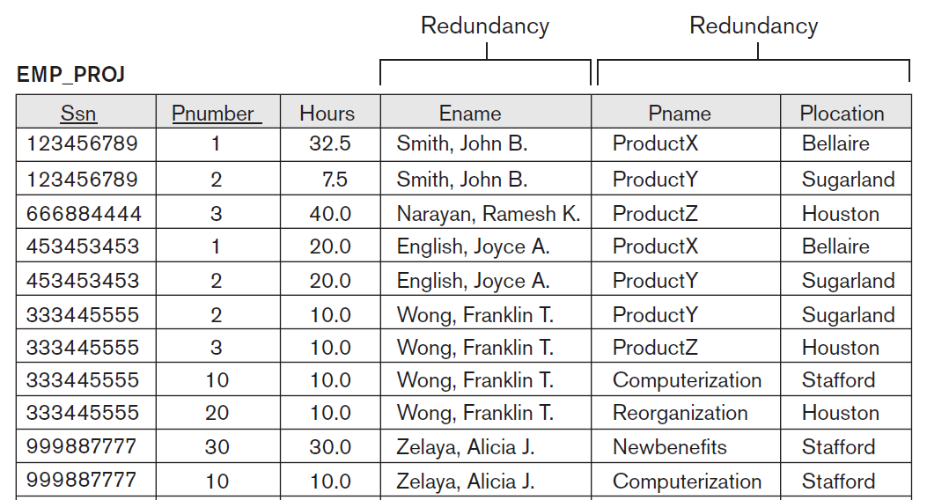

Slide 16
EXAMPLE OF A DELETE ANOMALY
Consider the relation:
EMP_PROJ(Emp#, Proj#, Ename, Pname, No_hours)
Delete Anomaly:
When a project is deleted, it will result in deleting all the employees who work on that project.
Alternately, if an employee is the sole employee on a project, deleting that employee would result in deleting the corresponding project.

Slide 18
EXAMPLE OF AN UPDATE ANOMALY
Consider the relation:
EMP_PROJ(Emp#, Proj#, Ename, Pname, No_hours)
Update Anomaly:
Changing the name of project number 1 from “Product X” to “Product Y” may cause this update to be made for all 100 employees working on project 1.

Slide 20
3. Null Values in Tuples
GUIDELINE 3:
Minimize the NULL values in tuples
Attributes that are NULL frequently could be placed in separate relations (with the primary key)

Slide 21
Reasons for Null
Attribute not applicable or invalid
(Visa_Status)
Attribute value unknown (may exist)
(Date_of_birth)
Value known to exist, but unavailable
(Home_Phone_Number)

Slide 22
4. Generation of Spurious Tuples – avoid at any cost
Design relation schemas so that they can be joined with equality conditions
No spurious tuples should be there.
Avoid relations that contain matching attributes that are not (foreign key, primary key) combinations
Bad designs for a relational database may result in erroneous results for certain JOIN operations
GUIDELINE 4:
No spurious tuples should be generated by doing a natural-join of any relations.

Slide 23
Functional Dependencies
A Functional Dependency (FD) is a constraint between attributes or two sets of attributes from the database (relation).

Slide 24
Functional Dependencies
Functional dependencies
Are used to specify formal measures of the "goodness" of relational designs
FDs are constraints that derived from the meaning and interrelationships of the data attributes
A set of attributes X functionally determines a set of attributes Y if the value of X determines a unique value for Y

Slide 25
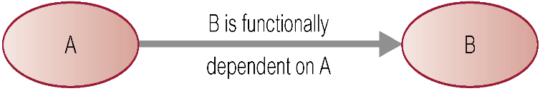
Defining Functional Dependencies
If A and B are attributes of relation R, B is functionally dependent on A (denoted A → B), if each value of A in R is associated with exactly one value of B in R.
X  Y holds if whenever two tuples have the same value for X, they must have the same value for Y
For any two tuples t1 and t2 in any relation instance r(R): If t1[X]=t2[X], then t1[Y]=t2[Y]
X  Y in R specifies a constraint on all relation instances r(R)
Written as X  Y; ( denoted by the arrow).
FDs are derived from the real-world constraints on the attributes

Slide 26
Examples of FD constraints (1)
Social security number determines employee name
SSN  ENAME
Project number determines project name and location
PNUMBER  {PNAME, PLOCATION}
Employee ssn and project number determines the hours per week that the employee works on the project
{SSN, PNUMBER}  HOURS

Slide 27
Examples of FD constraints (2)
An FD is a property of the attributes in the schema R
The constraint must hold on every relation instance r(R)
If K is a key of R, then K functionally determines all attributes in R
(since we never have two distinct tuples with t1[K]=t2[K])

Slide 28
Defining FDs from instances
Note that in order to define the FDs,
understand the meaning of the attributes
Given the instance (population) of a relation, all we can conclude is that an FD may exist between certain attributes.
What we can definitely conclude is – that certain FDs do not exist because there are tuples that show a violation of those dependencies.

Slide 29
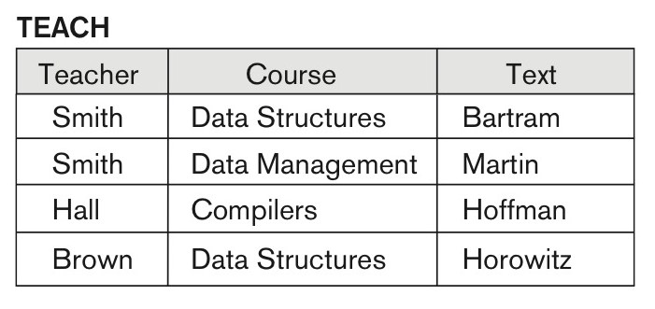
Example
Text → Course may exist.
However, the FDs Teacher → Course, Teacher → Text and Couse → Text are ruled out.

Slide 30
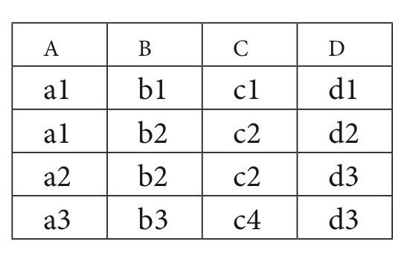
What FDs may exist?
A relation R(A, B, C, D) with its extension.

Slide 31
What FDs may exist?
FD holds
B -> C
C -> B
{A,B} -> C
{A,B} -> D
{A,C} -> B
{A,C} -> D
{A,D} -> B
{A,D} -> C
{B,D} -> A
{B,D} -> C
{C,D} -> A
{C,D} -> B
{A,B,C} -> D
{A,B,D} -> C
{B,C,D} -> A
FD not holds
A -> B
A -> C
A -> D
B -> A
B -> D
C -> A
C -> D
D -> A
D -> B
D -> C
{B,C} -> A
{B,C} -> D
Which FDs may exist in this relation?

Slide 32
Important Definitions
Determinant
Refers to the attribute, or group of attributes, on the left-hand side of the arrow of a functional dependency.
Full Functional dependency:
Indicates that if A and B are attributes of a relation, B is fully functionally dependent on A if B is functionally dependent on A, but not on any proper subset of A.
{StaffNo, StaffName} → BranchNo
StaffNo → BranchNo
Transitive Dependency
A condition where A, B, and C are attributes of a relation such that if A → B and B → C, then C is transitively dependent on A via B.

Slide 33
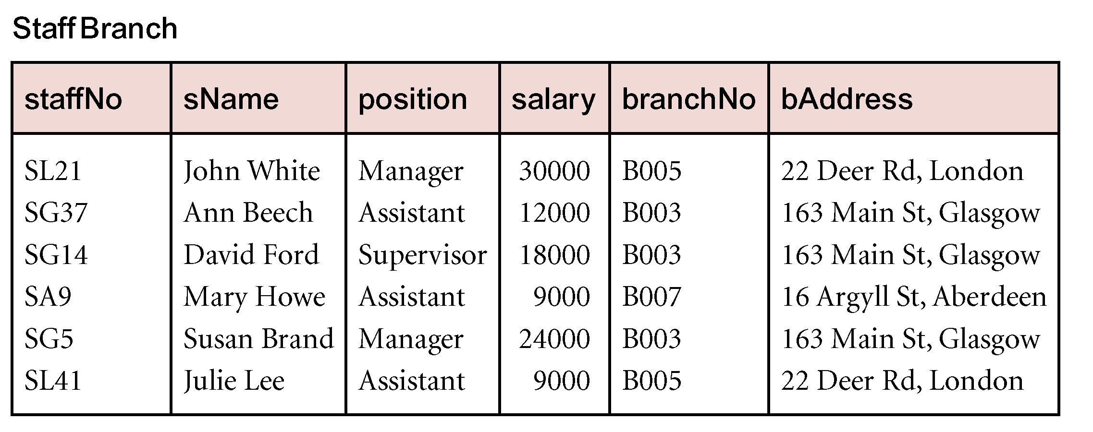
Example Transitive Dependency
Consider functional dependencies in the StaffBranch relation
staffNo → sName, position, salary, branchNo, bAddress
branchNo → bAddress
Transitive dependency:
staffNo → branchNo
branchNo → bAddress exists on staffNo via branchNo

